Slide 1
Minnesota Traffic Volume
In depth analysis of traffic patterns in the city
By Teddy Mutinge

Slide 2
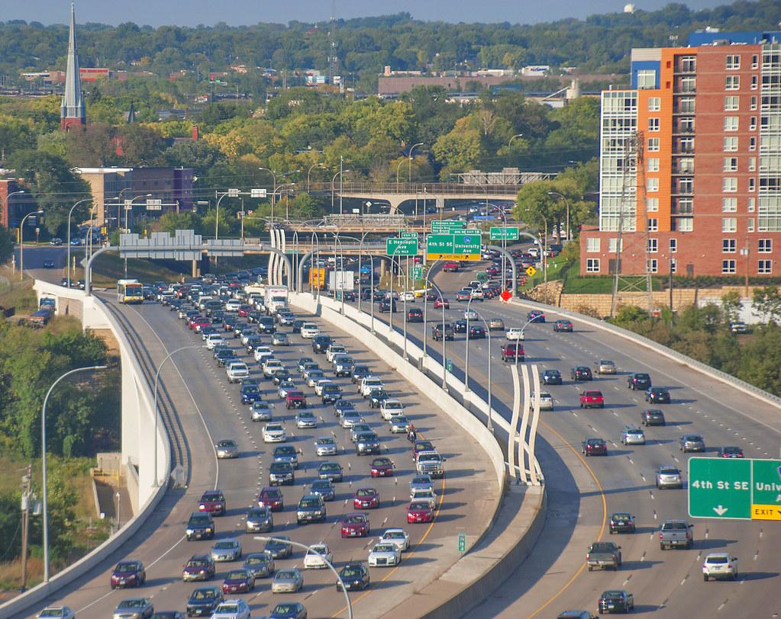
Traffic congestion continues to grow
…with no end

Slide 3



Analyzing based on three criteria
Time bound
Weather
Holiday travel

Slide 4
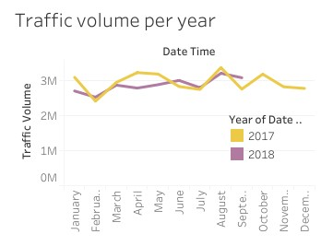
Monthly traffic volume
February - Significantly low volume, perfect for construction or renovation.
April - Significant decrease in 2018
August - Significantly high volume.

Slide 5
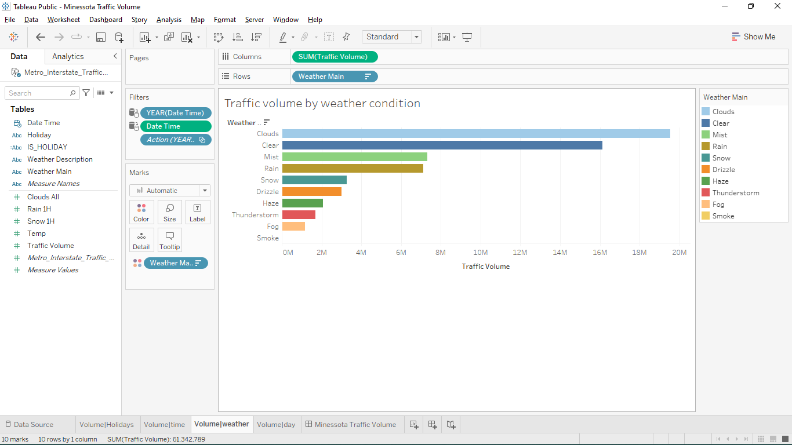
Impacts of weather
Clear/Cloudy conditions results to high traffic volume.
Low visibility conditions result to low traffic volumes.

Slide 6
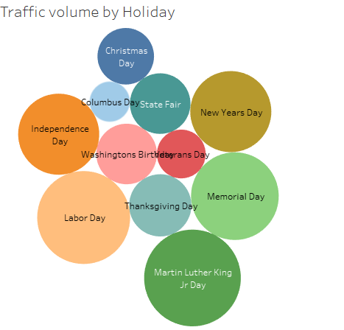
Holiday travel
High traffic volume is experienced on National holidays.
Most holidays have little impact on total traffic volume.

Slide 7
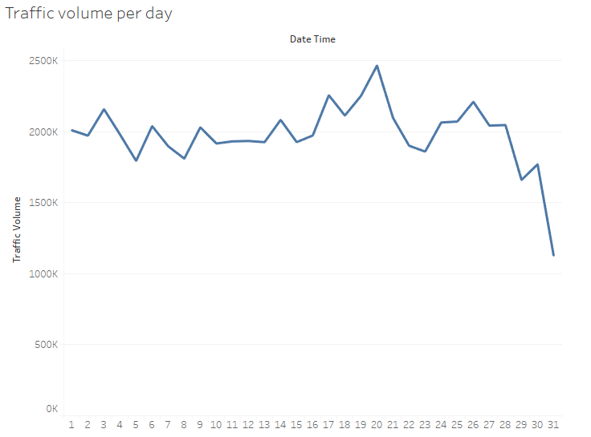
Daily traffic
Daily traffic volumes vary throughout the months with peaks experienced at mid month.
Daily traffic volumes is significantly higher on Holidays

Slide 8
Thank you!

